Slide 1
Basic Number Theory
Lecture 15-16

Slide 2
Importance of Number Theory
Number theory is crucial for encryption algorithms and hence to security.
Of utmost importance to everyone from Bill Gates, to the CIA, to Osama Bin Laden.
The encryption algorithms depend heavily on modular arithmetic.
Machinery (notations and techniques) for manipulating numbers

Slide 3
Divisors
DEF: Let a, b and c be integers such that
a = b ·c
- b and c are factors of a
-a is said to be a multiple of b (as well as of c).
The pipe symbol “|” denotes “divides” so the situation is summarized by:
b | a ∧ c | a .

Slide 4
Divisors Examples
Which of the following is true?
77 | 7
7 | 77
24 | 24
0 | 24
24 | 0

Slide 5
Divisors Examples
77 | 7: false bigger number can’t divide smaller positive number
7 | 77:
24 | 24:
0 | 24:
24 | 0:

Slide 6
Divisors Examples
77 | 7: false bigger number can’t divide smaller positive number
7 | 77: true because 77 = 7 · 11
24 | 24:
0 | 24:
24 | 0:

Slide 7
Divisors Examples
77 | 7: false bigger number can’t divide smaller positive number
7 | 77: true because 77 = 7 · 11
24 | 24: true because 24 = 24 · 1
0 | 24:
24 | 0:

Slide 8
Divisors Examples
77 | 7: false bigger number can’t divide smaller positive number
7 | 77: true because 77 = 7 · 11
24 | 24: true because 24 = 24 · 1
0 | 24: false, only 0 is divisible by 0
24 | 0:

Slide 9
Divisors Examples
77 | 7: false bigger number can’t divide smaller positive number
7 | 77: true because 77 = 7 · 11
24 | 24: true because 24 = 24 · 1
0 | 24: false, only 0 is divisible by 0
24 | 0: true, 0 is divisible by every number (0 = 24 · 0)

Slide 10
Multiples up to given n
How many positive multiples of 15 are less than 100?
Just list them:
15, 30, 45, 60, 75, 90
Therefore the answer is 6.
Q: How many positive multiples of 15 are less than 1,000,000?

Slide 11
Multiples up to given n
A: Listing is too much of a hassle. ⎣1,000,000/15⎦.
In general: The number of d-multiples less than N is given by:
|{m ∈ Z⁺ | d |m and m ≤ N }| = ⎣N/d⎦

Slide 12
Divisor Theorem
THM: Let a, b, and c be integers. Then:
a|b ∧ a|c → a|(b + c )
a|b → a|bc
a|b ∧ b|c → a|c
EG:

Slide 13
Divisor Theorem
THM: Let a, b, and c be integers. Then:
a|b ∧ a|c → a|(b + c )
a|b → a|bc
a|b ∧ b|c → a|c
EG:
17|34 ∧ 17|170 → 17|204

Slide 14
Divisor Theorem
THM: Let a, b, and c be integers. Then:
a|b ∧ a|c → a|(b + c )
a|b → a|bc
a|b ∧ b|c → a|c
EG:
17|34 ∧ 17|170 → 17|204
17|34 → 17|340

Slide 15
Divisor Theorem
THM: Let a, b, and c be integers. Then:
a|b ∧ a|c → a|(b + c )
a|b → a|bc
a|b ∧ b|c → a|c
EG:
17|34 ∧ 17|170 → 17|204
17|34 → 17|340
6|12 ∧ 12|144 → 6 | 144

Slide 16
Divisor Theorem
In general, such statements are proved by starting from the definitions and manipulating to get the desired results.
EG. Proof of no. 2 (a|b → a|bc ):
Suppose a|b.
Then there exist m such that b = am.
Multiply both sides by c to get bc = amc = a (mc ).
Consequently, bc has been expressed as a times the integer mc so by definition of “|”, a|bc 

Slide 17
Prime Numbers
A number n ≥ 2 prime if it is only divisible by 1 and itself.
A number n ≥ 2 which isn’t prime is called composite.
Q: Which of the following are prime?
0,1,2,3,4,5,6,7,8,9,10

Slide 18
Prime Numbers
A: 0, and 1 not prime since not positive and greater or equal to 2
2 is prime as 1 and 2 are only factors
3 is prime as 1 and 3 are only factors.
4,6,8,10 not prime as non-trivially divisible by 2.
5, 7 prime.
9 = 3 · 3 not prime.
Last example shows that not all odd numbers are prime.

Slide 19
Fundamental Theorem of Arithmetic
Any number n ≥ 2 is expressible as a unique product of 1 or more prime numbers.
Note: prime numbers are considered to be “products” of 1 and prime.
We’ll need induction and some more number theory tools to prove this.
Q: Express each of the following number as a product of primes: 22, 100, 12, 17

Slide 20
Fundamental Theorem of Arithmetic
22 = 2·11,
100 = 2·2·5·5,
12 = 2·2·3,
17 = 17

Slide 21
Primality Testing
Prime numbers are very important in encryption schemes. Essential to be able to verify if a number is prime or not. It turns out that this is quite a difficult problem. First try:
boolean isPrime(integer n)
if ( n < 2 ) return false
for(i = 2 to n -1)
if( i |n ) // “divides”
return false
return true
Q: What is the running time of this algorithm?

Slide 22
Primality Testing
A: Assuming divisibility testing is a basic operation –then above primality testing algorithm is O (n).
Q: What is the running time in terms of the input size k ?

Slide 23
Primality Testing
A: Consider n = 1,000,000. The input size is k = 7 because n was described using only 7 digits. In general we have
n = O (10^{k} ). Therefore, running time is O (10^{k} ).
Q: Can we improve the algorithm?

Slide 24

Primality Testing
A:
Don’t try number bigger than n/2
After trying 2, don’t try any other even numbers, because know n is odd by this point.
In general, try only smaller prime numbers
In fact, only need to try to divide by prime numbers no larger than as we’ll see next:

Slide 25

Primality Testing
LEMMA: If n is a composite, then its smallest prime factor is ≤
Proof (by contradiction). 1<a<n
n=ab
a<=n or b<=n
if a> and b> then ab> n

Slide 26
Primality Testing
EG: Test if 139 and 143 are prime.
List all primes up to and check if they divide the numbers.
2: Neither is even
3: Sum of digits trick: 1+3+9 = 13, 1+4+3 = 8 so neither divisible by 3
5: Don’t end in 0 or 5
7: 140 divisible by 7 so neither div. by 7
11: Alternating sum trick: 1-3+9 = 7 so 139 not div by 11. 1-4+3 = 0 so 143 is divisible by 11.
STOP! Next prime 13 need not be examined since bigger than .
Conclude: 139 is prime, 143 is composite.

Slide 27
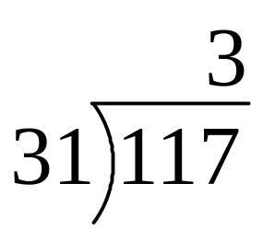
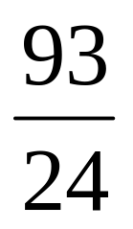
Division
Remember long division?
117 = 31·3 + 24
a = dq + r
q the quotient
d the divisor
a the dividend
r the remainder

Slide 28
Division
THM: Let a be an integer, and d be a positive integer. There are unique integers q, r with r ∈ {0,1,2,…,d-1} satisfying
a = dq + r

Slide 29
GCD and Relatively Prime
DEF Let a,b be integers, not both zero. The greatest common divisor of a and b (or gcd(a,b) ) is the biggest number d which divides both a and b.
DEF: a and b are said to be relatively prime if gcd(a,b) = 1, so no prime common divisors.

Slide 30
GCD and Relatively Prime
gcd(11,77) = 11
gcd(33,77) = 11
gcd(24,36) = 12
gcd(24,25) = 1. Therefore 24 and 25 are relatively prime.
NOTE: A prime number are relatively prime to all other numbers which it doesn’t divide.

Slide 31
GCD and Relatively Prime
EG: More realistic. Find gcd(98,420).
Find prime decomposition of each number and find all the common factors:
98 = 2·49 = 2·7·7
420 = 2·210 = 2·2·105 = 2·2·3·35 = 2·2·3·5·7
Underline common factors: 2·7·7, 2·2·3·5·7
Therefore, gcd(98,420) = 14

Slide 32
Least Common Multiple
DEF: The least common multiple of a, and b (lcm(a,b) ) is the smallest number m which is divisible by both a and b.
Q: Find the lcm’s:
lcm(10,100)
lcm(7,5)
lcm(9,21)

Slide 33
Least Common Multiple
A:
lcm(10,100) = 100
lcm(7,5) = 35
lcm(9,21) = 63
THM: lcm(a,b) = ab / gcd(a,b)
Notes:
Skip proof in lecture

Slide 34
Modular Arithmetic
There are two types of “mod” (confusing):
the mod function
  Inputs a number a and a base b
  Outputs a mod b a number between 0 and b –1 inclusive
  This is the remainder of a÷b
  Similar to Java’s % operator.
the (mod) congruence
  Relates two numbers a, a’ to each other relative some base b
  a ≡ a’ (mod b) means that a and a’ have the same remainder when dividing by b

Slide 35
mod function
Similar to Java’s “%” operator except that answer is always positive. E.G.
-10 mod 3 = 2, but in Java –10%3 = -1.
Q: Compute
113 mod 24
-29 mod 7

Slide 36
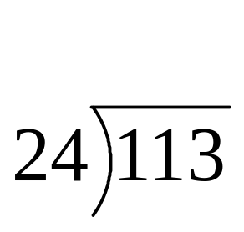
mod function
A: Compute
113 mod 24:
-29 mod 7

Slide 37
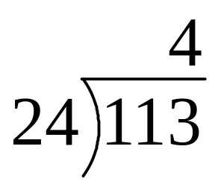
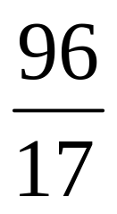
mod function
A: Compute
113 mod 24:
-29 mod 7

Slide 38
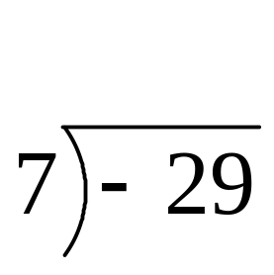
mod function
A: Compute
113 mod 24:
-29 mod 7

Slide 39
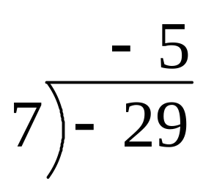
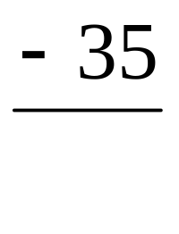

mod function
A: Compute
113 mod 24:
-29 mod 7

Slide 40
(mod) congruence Formal Definition
Let a,a’ be integers and b be a positive integer. We say that a is congruent to a’ modulo b (denoted by a ≡ a’ (mod b) ) iff b | (a – a’ ).
Equivalently: a mod b = a’ mod b
Q: Which of the following are true?
3 ≡ 3 (mod 17)
3 ≡ -3 (mod 17)
172 ≡ 177 (mod 5)
-13 ≡ 13 (mod 26)

Slide 41
(mod) congruence
A:
3 ≡ 3 (mod 17) True.
any number is congruent to itself (3-3 = 0, divisible by all)
3 ≡ -3 (mod 17) False.
(3-(-3)) = 6 isn’t divisible by 17.
172 ≡ 177 (mod 5) True.
172-177 = -5 is a multiple of 5
-13 ≡ 13 (mod 26) True.
-13-13 = -26 divisible by 26.

Slide 42
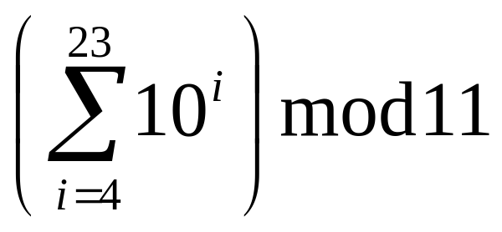
Modular arithmetic harder examples
Q: Compute the following.
307¹⁰⁰¹ mod 102

Slide 43
Modular arithmetic harder examples
A: Use the previous identities to help simplify:
Using multiplication rules, before multiplying (or exponentiating) can reduce modulo 102:
307¹⁰⁰¹ mod 102 ≡ 307¹⁰⁰¹ (mod 102)
≡ 1¹⁰⁰¹ (mod 102) (102X3)
≡ 1 (mod 102).
Therefore, 307¹⁰⁰¹ mod 102 = 1.

Slide 44
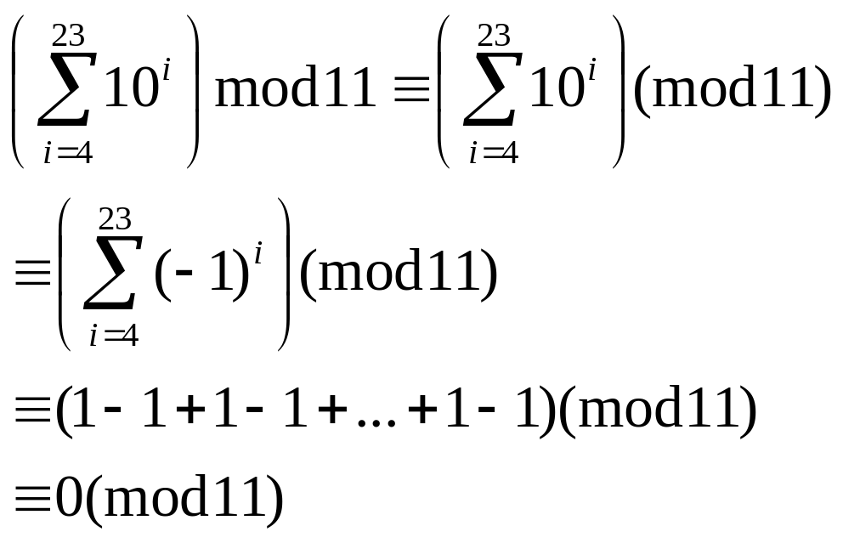
Modular arithmetic harder examples
A: Use the previous identities to help simplify:
2. Similarly, before taking sum can simplify modulo 11:
Therefore, the answer is 0.
10-(-1)

Slide 45
Simple Encryption
Variations on the following have been used to encrypt messages for thousands of years.
Convert a message to capitals.
Think of each letter as a number between 1 and 26.
Apply an invertible modular function to each number.
Convert back to letters (0 becomes 26).

Slide 46
Caesar Cipher
earliest known substitution cipher
by Julius Caesar
first attested use in military affairs
replaces each letter by 3rd letter on
example: f (a) = (a+3) mod 26
P | m | e | e | t |  | m | e |  | a | f | t | e | r |  | t | h | e |  | t | o | g | a |  | p | a | r | t | y
C | P | H | H | W |  | P | H |  | D | I | W | H | U |  | W | K | H |  | W | R | J | D |  | S | D | U | W | B
Notes:
Substitution ciphers form the first of the fundamental building blocks. The core idea is to replace one basic unit (letter/byte) with another. Whilst the early Greeks described several substitution ciphers, the first attested use in military affairs of one was by Julius Caesar, described by him in Gallic Wars (cf. Kahn pp83-84). Still call any cipher using a simple letter shift a caesar cipher, not just those with shift 3.

Slide 47
Caesar Cipher
can define transformation as:
  a b c d e f g h i j k l m n o p q r s t u v w x y z
  D E F G H I J K L M N O P Q R S T U V W X Y Z A B C
mathematically give each letter a number
  a b c d e f g h i j k l m n o p q r s t u v w x y z
  0 1 2 3 4 5 6 7 8 9 10 11 12 13 14 15 16 17 18 19 20 21 22 23 24 25
then have Caesar cipher as:
  c = E(p) = (p + k) mod (26)
  p = D(c) = (c – k) mod (26)
Notes:
This mathematical description uses modulo (clock) arithmetic. Here, when you reach Z you go back to A and start again. Mod 26 implies that when you reach 26, you use 0 instead (ie the letter after Z, or 25 + 1 goes to A or 0).
Example: howdy (7,14,22,3,24) encrypted using key f (ie a shift of 5) is MTBID

Slide 48
Monoalphabetic Cipher
rather than just shifting the alphabet
could shuffle (jumble) the letters arbitrarily
each plaintext letter maps to a different random ciphertext letter
hence key is 26 letters long
  Plain: abcdefghijklmnopqrstuvwxyz
  Cipher: DKVQFIBJWPESCXHTMYAUOLRGZN
  Plaintext: ifwewishtoreplaceletters
  Ciphertext: WIRFRWAJUHYFTSDVFSFUUFYA
Notes:
With only 25 possible keys, the Caesar cipher is far from secure. A dramatic increase in the key space can be achieved by allowing an arbitrary substitution, where the translation alphabet can be any permutation of the 26 alphabetic characters.
See example translation alphabet, and an encrypted message using it.

Slide 49
Monoalphabetic Cipher
only have 26 possible ciphers
  A maps to A,B,..Z
could simply try each in turn
a brute force search
given ciphertext, just try all shifts of letters (1 to 25 in the previous case)
do need to recognize when have plaintext
Notes:
With a caesar cipher, there are only 26 possible keys, of which only 25 are of any use, since mapping A to A etc doesn't really obscure the message! Note this basic rule of cryptanalysis "check to ensure the cipher operator hasn't goofed and sent a plaintext message by mistake"!
Can try each of the keys (shifts) in turn, until can recognise the original message. See Stallings Fig 2.3 for example of search.
Note: as mentioned before, do need to be able to recognise when have an original message (ie is it English or whatever). Usually easy for humans, hard for computers. Though if using say compressed data could be much harder.
Example "GCUA VQ DTGCM" when broken gives "easy to break", with a shift of 2 (key C).

Slide 50
Example Cryptanalysis
given ciphertext:
  UZQSOVUOHXMOPVGPOZPEVSGZWSZOPFPESXUDBMETSXAIZ
  VUEPHZHMDZSHZOWSFPAPPDTSVPQUZWYMXUZUHSX
  EPYEPOPDZSZUFPOMBZWPFUPZHMDJUDTMOHMQ
count relative letter frequencies
guess P & Z are e and t
guess ZW is th and hence ZWP is the
proceeding with trial and error finally get:
  it was disclosed yesterday that several informal but
  direct contacts have been made with political
  representatives of the viet cong in moscow
Notes:
Illustrate the process with this example from the text in Stallings section 2.2.

Slide 51
Thank You

Slide 52
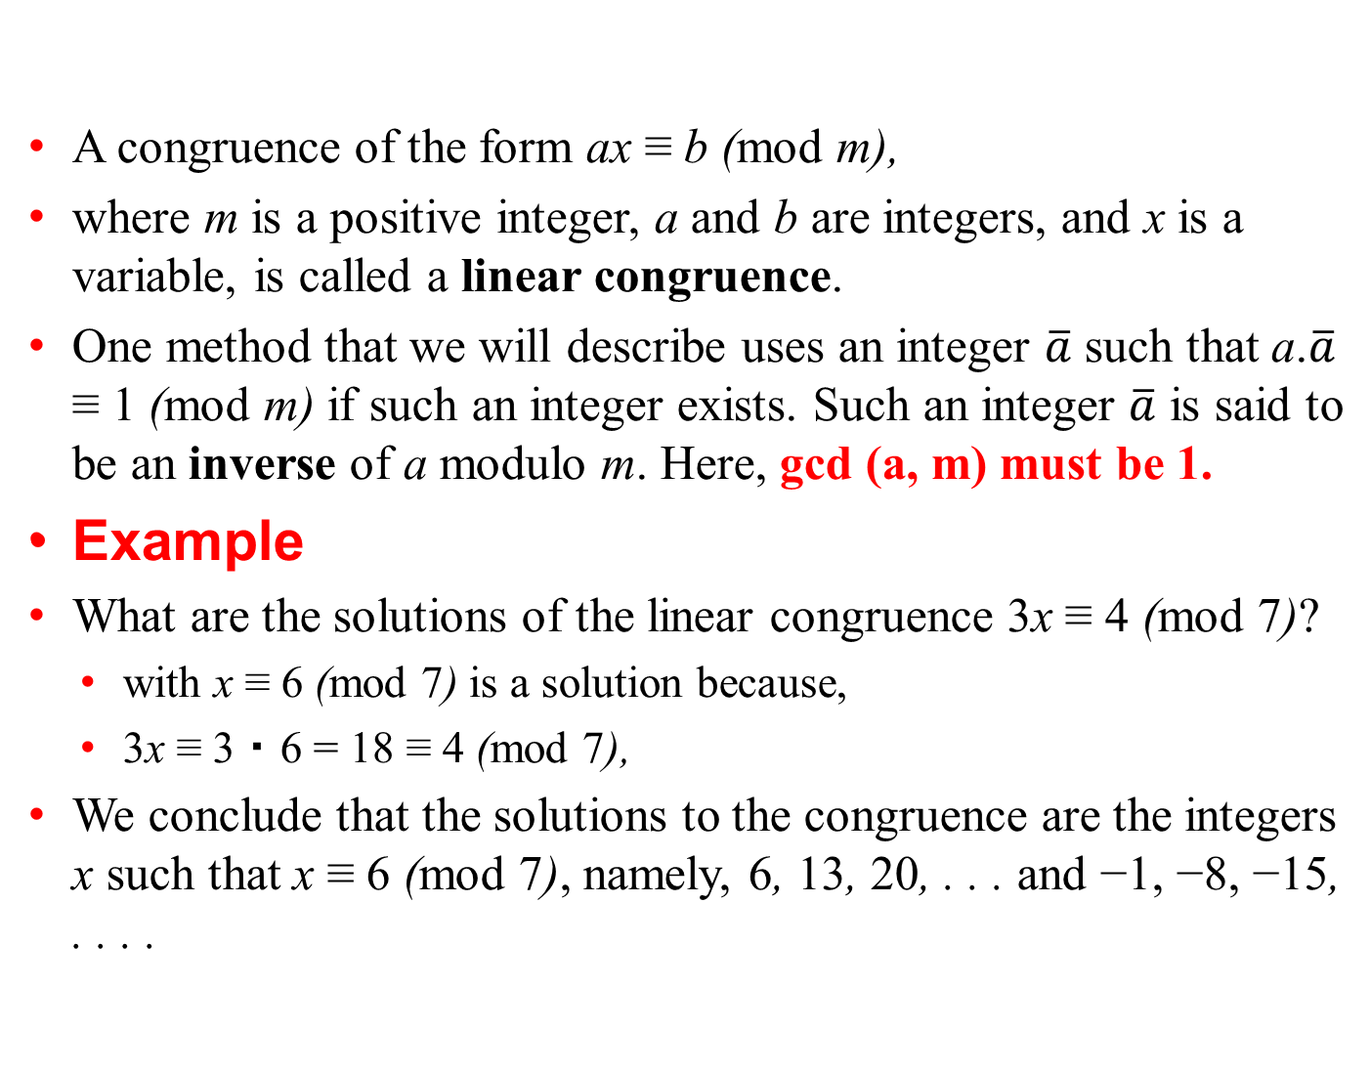
(mod) congruence

Slide 53
Chinese Reminder Theorem
Let m1,m2, . . . , mn be pairwise relatively prime positive integers greater than one and a1, a2, . . . ,an arbitrary integers. Than the system
  x ≡ a1 (mod m1),
  x ≡ a2 (mod m2),
  ・
  ・
  ・
  x ≡ an (mod mn)
has a unique solution modulo m = m1m2 ・ ・ ・mn. (That is, there is a solution x with 0 ≤ x <m, and all other solutions are congruent modulo m to this solution.)

Slide 54
Chinese Reminder Theorem
To construct a simultaneous solution, first, let
Mk = m/mk
for k = 1, 2, . . . , n.
we know that there is an integer yk, an inverse of Mk modulo mk, such that
Mkyk ≡ 1 (mod mk).
To construct a simultaneous solution, form the sum
x = a1M1y1 + a2M2y2 +・ ・ ・+anMnyn.

Slide 55
Chinese Reminder Theorem
Example
What is the smallest positive integer, when divided by 3, the remainder is 2; when divided by 5, the remainder is 3; and when divided by 7, the remainder is 2. What will be the number of things?
This puzzle can be translated into the following question: What are the solutions of the systems of congruences
x ≡ 2 (mod 3),
x ≡ 3 (mod 5),
x ≡ 2 (mod 7)
At first let m = 3 ・ 5 ・ 7 = 105,
M1 = m/3 = 35,M2 = m/5 = 21, and M3 = m/7 = 15

Slide 56
Chinese Reminder Theorem
Example
We see that 2 is an inverse of M1 = 35 modulo 3, because
35 ・ 2 ≡ 2 ・ 2 ≡ 1 (mod 3);
1 is an inverse of M2 = 21 modulo 5, because 21 ≡1 (mod 5);
1 is an inverse of M3 = 15 (mod 7), because 15 ≡ 1 (mod 7).
The solutions to this system are those x such that
x ≡ a1M1y1 + a2M2y2 + a3M3y3
  = 2 ・ 35 ・ 2 + 3 ・ 21 ・ 1 + 2 ・ 15 ・ 1
= 233 ≡ 23 (mod 105).
It follows that 23 is the smallest positive integer that is a simultaneous solution.

